Slide 1
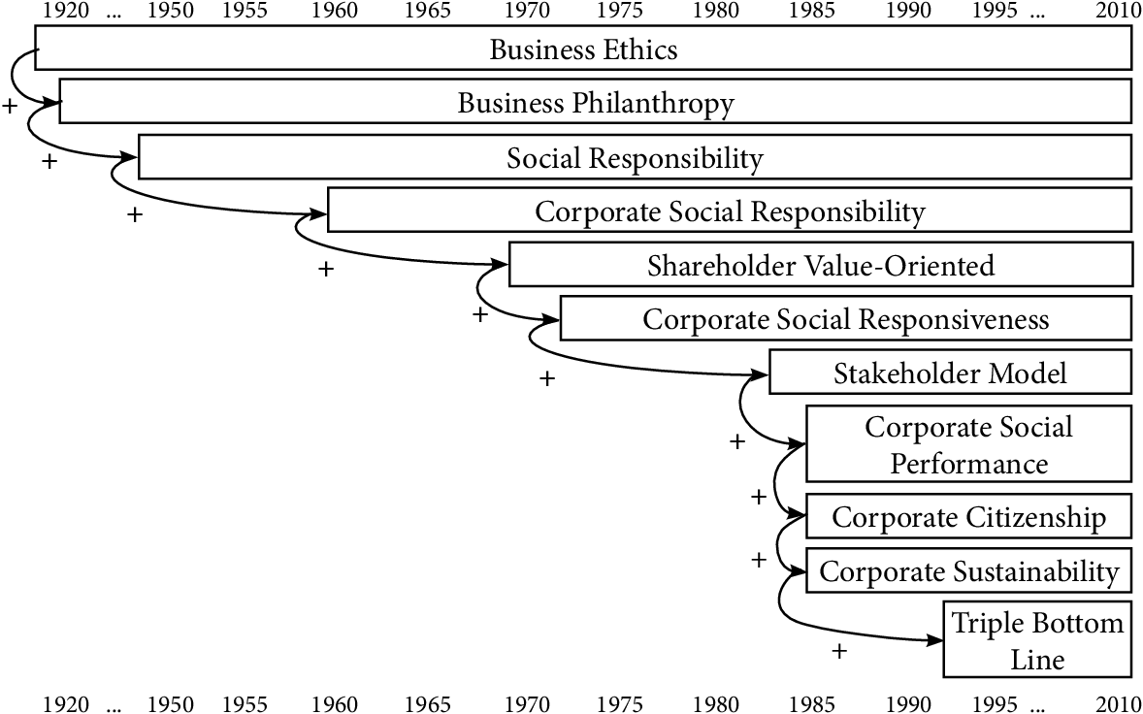
Evolution of CSR

Slide 2
Evolution of CSR
Corporate Social Responsibility (CSR) has come a long way, morphing from a nice thing to do to what it is today:
a necessity for a successful business.
The term “Corporate Social Responsibility,” however, was not coined until 1953, when American economist Howard Bowen published Social Responsibilities of the Businessman. In this book, Bowen identified the great power of corporations and recognized that their actions had a tangible impact on society. Therefore, he argued, businessmen have an obligation to pursue policies that are beneficial for the common good.
https://www.smartsimple.com/blog/2019/3/29/a-brief-history-of-csr

Slide 3
Companies are starting to care more about corporate social responsibility
Consumers
84% of global consumers consider sustainability important when choosing a brand. [Sustainability at a Turning Point, IBM, 2021]
EMPLOYEES
66% of employees report a greater sense of loyalty to their employers as a consequence of participating in CSR programs. [“Closing the Racial Inequality Gaps” Citi, 2020]
C-SUITE/BOARD MEMBERS
87% of CEOs said purpose is central to building their brand reputation. [KPMG CEO Outlook, 2021]
INVESTORS
93% of U.S. investors expect the companies they invest in to increase their prioritization of ESG initiatives. [2021 Edelman Trust Barometer]

Slide 4
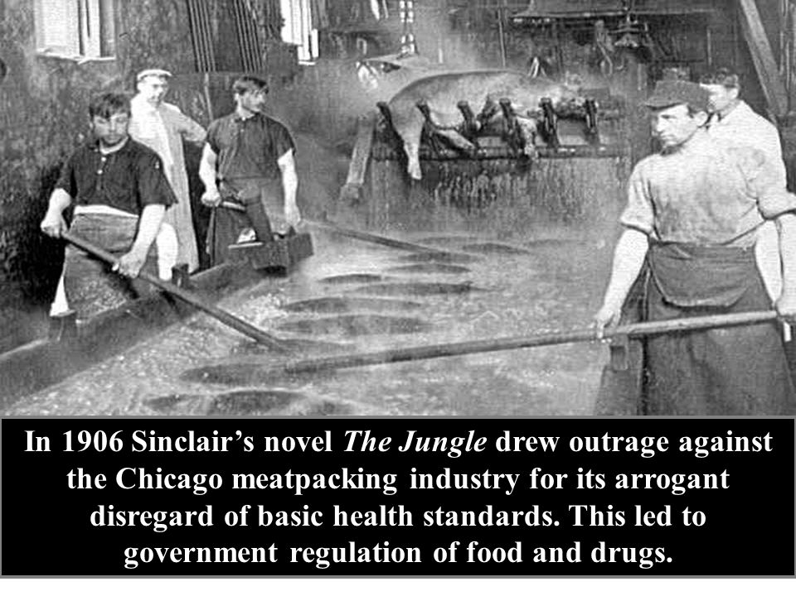
Corporate social responsibility has its roots in the Industrial Revolution
Industrial Revolution and World War
Corporate social responsibility has its roots in the Industrial Revolution.
The Industrial Revolution led to a reorganization of society around corporations.
Farmers moved to cities and company towns to take higher-paying jobs in factories.
The late 19th and early 20th century are often viewed as a period of corporate irresponsibility.
Indeed, this era did produce mass worker exploitation, unsafe working conditions, and excessive pollution. Upton Sinclair captured this strife
in his 1905 novel The Jungle, which focused on the Chicago meatpacking industry.

Slide 5
Yet successful early industrialists recognized the necessity of corporate social responsibility.
Leading corporations realized that healthy employees improved productivity and profits.
Others took a spiritual interest in helping the less fortunate and giving back.
Milton Hershey exhibited both of these motivations when he founded his chocolate company in 1894.
He designed a park for his company town and made sure that factory families had access to leisure activities.
The town also included a community greenhouse and plant nursery, and Hershey employees received cheap credit that allowed most to become homeowners.
In 1909, Hershey and his wife Catherine established the Milton Hershey School for orphans. The boarding school still serves over 2,000 in-need students across 14 grades tuition-free.

Slide 6
Wartime patriotism accelerated the development of corporate social responsibility
Wartime patriotism accelerated the development of corporate social responsibility.
American companies donated food and supplies to Allied nations under the Lend-Lease Act during World War II.
Corporations repurposed factories to meet critical supply shortages.

Slide 7
Business’s contribution to the war effort reinforced the idea that private enterprise includes civic duties.
A cross-sectional study of Minnesota companies shows how corporations adopted CSR efforts to wartime.
Spam-manufacturer Hormel contributed heavily to the Lend-Lease program.
3M developed new adhesives to help pilots and healthcare workers.
General Mills and Pillsbury developed education programs to help households survive on rations.
Food company Cargill temporarily became a shipbuilder.
These alliances between business and government had long-lasting effects on companies’ approaches to corporate social responsibility.

Slide 8
Post-War: Civil Rights and Sustainability
Corporations took an active role in defining their place in society after World War II.
Executives experienced new pressures to serve as a social force for good.
These pressures included the increasing influence of unions and globalization, the threat of communism, and growing public unease about ballooning mega-corporations.
More corporate leaders began to understand that their businesses carried responsibilities beyond their four walls.

Slide 9
Howard Bowen
In 1953, academic Howard Bowen described corporate social responsibility as “the obligations of businessmen to pursue those policies, to make those decisions, or to follow those lines of action which are desirable in terms of the objectives and values of our society.”
Bowen’s systematization of corporate social responsibility has earned him the title of “Father of Corporate Social Responsibility.”

Slide 10
The Civil Rights
The Civil Rights Era challenged organizations to take a stand on social justice issues. Small black-owned businesses provided vital material support to activists through the 1960s.
Behind towering figures like Rosa Parks and Martin Luther King, Jr. were the taxi dispatchers, pharmacists, grocers, and other small business owners who were instrumental in making civil rights a reality
.

Slide 11

Environmental movement
Mid-20th century corporations also responded to the nascent environmental movement.
Books like Rachel Carson’s Silent Spring (1962) and Ralph Nader’s Unsafe at Any Speed (1965) highlighted the drawbacks of businesses’ postwar acceleration.
Throughout the 1970s and 1980s, brands not only responded to environmental regulations but also made voluntary “green” changes.
This period produced brands recognized today for their environmental consciousness, such as Whole Foods and Burt’s Bees.

Slide 12
Today’s State of CSR
Today’s prevailing corporate social responsibility strategies took shape in the final decades of the 20th century. CSR took on. a more formal role within corporations of the 1980s
Businesses began to earmark resources for dedicated CSR departments and leaders.
Over time, executives began to understand that their companies should avoid isolating these departments. Leading companies have drawn on CSR principles to inform all manner of organizational decisions.
Organizations have closely allied CSR with marketing, Public Relations, diversity and inclusion, and human resources. CSR plays a leading role in telling brands’ stories and attracting top talent. More importantly, brands have leveraged CSR to orient their company’s purpose and vision.

Slide 13
Stakeholders
Consensus has emerged that businesses exist to provide value for all stakeholders — customers, employees, suppliers, and the global community, not just shareholders.
The Business Roundtable reflected this consensus in its 2019 statement on the purpose of the corporation, which was signed by 181 Fortune 500 CEOs.

Slide 14
“Corporate Social Justice.”
Harvard Business Review speculates that we are entering an era of “Corporate Social Justice.”
HBR describes corporate social justice as “a reframing of CSR that centers the focus of any initiative or program on the measurable, lived experiences of groups harmed and disadvantaged by society.”
Corporate social justice requires “deep integration” with all of a business’s core functions.

Slide 15
Reverse Global Change
Customers and employees have similarly raised the bar with respect to sustainability.
Leading sustainability practices have already shifted focus from minimizing local harm to reversing global climate change.
Enterprising organizations like Terrapass will help companies go from carbon-neutral to carbon-negative. An accredited and independent (accounting firm verifies that we are realizing the exact number of emissions reductions)

Slide 16
Companies are starting to care more about corporate social responsibility (CSR).
Among the largest 250 companies in the world, 92% produced a CSR report in 2015, informing shareholders and the public about the firm’s activities.
That’s up from 64% having such a report in 2005. Today, Fortune Global 500 firms spend around $20 billion a year on CSR activities.

Slide 17


Slide 18
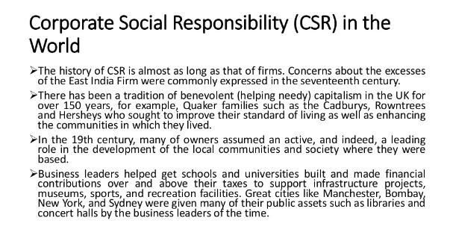

Slide 19
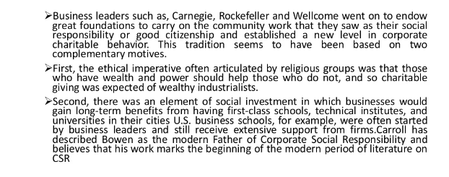

Slide 20
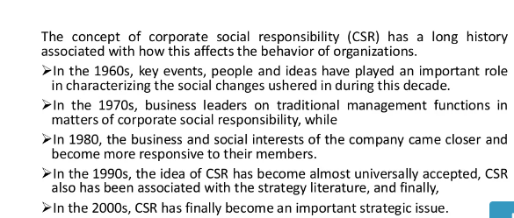

Slide 21
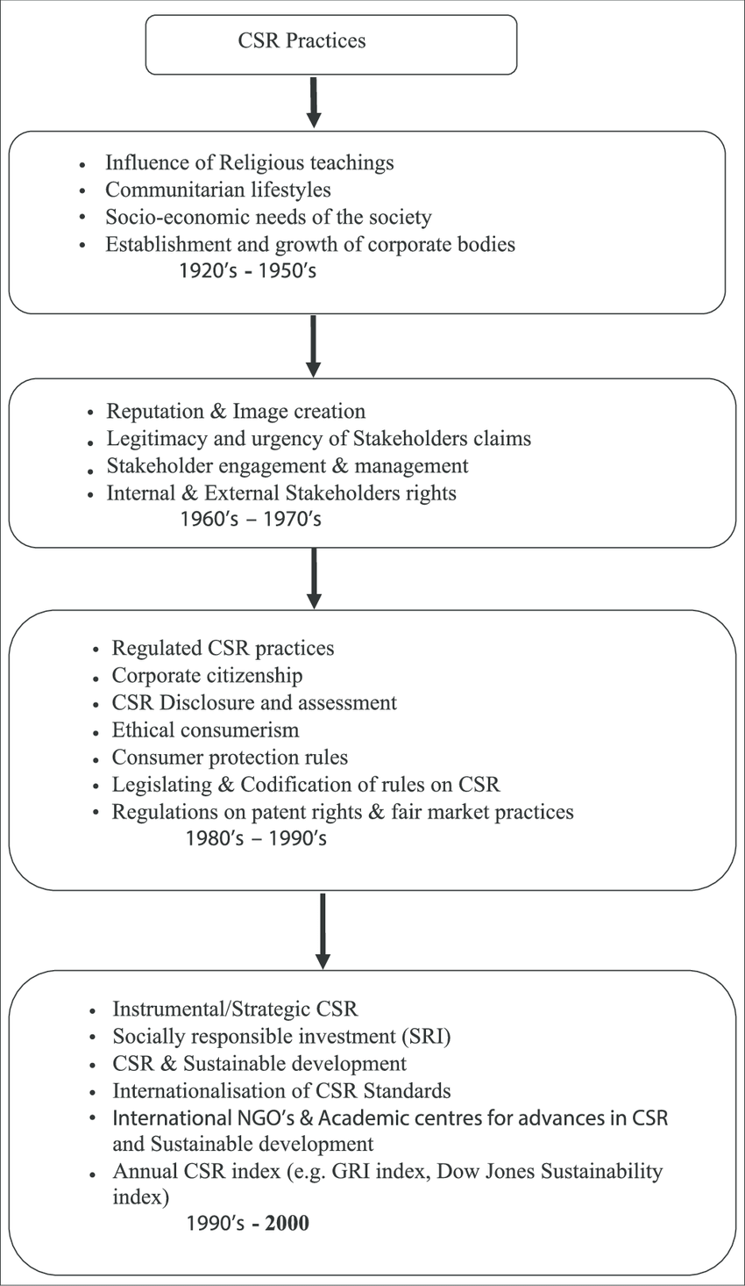

Slide 22
Historical roots of social responsibility
The origins of the social component in corporate behavior can be traced back to the ancient Roman Laws and can be seen in entities such as asylums, homes for the poor and old, hospitals and orphanages.
This notion of corporations as social enterprises was carried on with the English Law during the Middle Ages in academic, municipal and religious institutions.
Later, it expanded into the sixteenth and seventeenth centuries with the influence of the English Crown, which saw corporations as an instrument for social development.
In the following centuries, with the expansion of the English Empire and the conquering of new lands, the English Crown exported its corporate law to its American colonies where corporations played a social function to a certain extent

Slide 23
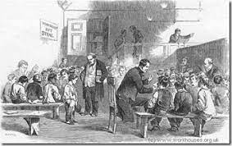

Slide 24
Historical roots of social responsibility contd…
During the eighteenth and nineteenth centuries, the Christian religious philosophy and approach to the abiding social context were seen as a response to the moral failure of society, which was visible in terms of poverty of the overall population in the English Empire and some parts of Europe.
This religious approach gave way to social reforms and to the Victorian philanthropy which perceived a series of social problems revolving around poverty and ignorance as well as child and female labor.
The religious roots of the Victorian social conscience gave Victorian Philanthropists a high level of idealism and humanism, and by the late 1800’s, the philanthropic efforts focused on the working class and the creation of welfare schemes with examples that could be seen in practice both in Europe as in the United States of America.

Slide 25
Quality of life-Employees
During the late 1800’s and early 1900’s, the creation of welfare schemes took a paternalistic approach aimed at protecting and retaining employees and some companies even looked into improving their quality of life.
There were clear examples that reflected the social sensitivity of businessmen, such as the case of Macy’s in the USA, which in 1875 contributed funds to an orphan asylum and by 1887 labeled their charity donations as Miscellaneous Expenses within their accounting books, and the case of Pullman Palace Car Company which created a model industrial community in 1893 with the aim of improving the quality of life of its employees.

Slide 26
Growing level of urbanization and industrialization
During this period, there was a growing level of urbanization and industrialization marked by large-scale production.
This brought new concerns to the labor market such as: new challenges for farmers and smalls corporations to keep up with the new interdependent economy, the creation of unions of workers looking for better working conditions, and a middle class worried for the loss of religious and family values in the new industrial society .
As a response to these new challenges, and with the aim of finding harmony between the industry and the working force, some business leaders created organizations for the promotion of values and improvement of the working conditions.

Slide 27
CSR- the early Charitable Impulse
Checkbook Philanthropy
A traditional passive form of Corporate Philanthropy characterized by donations to multiple worthy causes without any relationship to business strategy.
Charity by owners continued in the early 19th century. Mostly, new millionaires endowed social causes as individuals, not through companies.
Andrew Carnegie gave $350 mn. During his life to social causes, built 2,811 public libraries.
He wrote a famous article” The Disgrace of Dying rich” argued that this was the duty of wealthy man to consider all surplus revenues as trust funds .

Slide 28
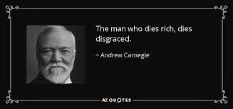
In an 1889 essay, steel magnate Carnegie told his fellow business leaders, "The man who dies thus rich dies disgraced." Carnegie believed that the wealthy should repay their debt to society.
True to his beliefs, by his death in 1919 he had divested himself of more than 95 percent of his fortune..
He provided pensions for professors at universities that agreed to meet strict academic standards.
In addition to funding music halls, outdoor swimming pools, and church organs, he also set up endowments to promote teaching and world peace.
He built a library building for any town that would provide a site, stock the building with books, and guarantee maintenance expenses

Slide 29
Strategic Philanthropy
A form of Corporate philanthropy in which charitable activities reinforce strategic business goals.
E.g. Mattel donated $25 mn. To put it’s name on the children’s hospital now called Mattel’s Children Hospital.
The co. has no role in running the hospital, although it gives toys to patients.
Adding the co. name adds to the brand recognition & contributes to compassionate Corporate image among toy buyers.
These benefits reinforce the commercial goals of a toy co. while also helping sick children.

Slide 30
Porter & Kramer ‘Strategy and society: The link between competitive advantage and corporate social responsibility’.
Strategic CSR
Although businesses have become increasingly aware of stakeholder pressure to demonstrate a commitment to their corporate social responsibilities (CSR), this does not necessarily mean the adoption of an integrated and strategic approach to CSR.
Rather, as Michael Porter (Harvard Business School, Boston) and Mark Kramer (John F Kennedy School of Government, Massachusetts) have recently argued in the Harvard Business Review (December 2006), current approaches to CSR are fragmented and disconnected from business goals.
.

Slide 31
This has resulted in disparate and reactive initiatives designed to mollify vocal stakeholders or deflect attention from questionable business practices, and these have justifiably been criticised as ‘feel good’ marketing campaigns which have failed to generate bottom line benefits.

Slide 32
Companies which have responded to their CSR have usually done so for one, or a combination, of the following four reasons/principles –
Moral obligation,
Sustainability,
Compliance
Reputation
‘Moral obligation’ refers to the compulsion for companies to be ‘good citizens’ and ‘do the right thing’.
The sustainability argument emphasises the need for companies to have regard to the natural environment from which resources are drawn.
The compliance or ‘licence to operate’ argument reflects a pragmatic response to agendas set by Government regulators.
Reputation impetus is all about creating a positive impression on consumers, staff and shareholders.

Slide 33
Weakness in all 4 Schools
Porter and Kramer argue that there is an inherent weakness in all four school of thought, namely they “focus on the tension between business and society, rather than their interdependence”.
Further “each strategy creates a generic rationale that is not tied to the strategy and operations of any specific company or the places in which it operates”.
Deficiencies in approach to CSR have resulted in unco-ordinated and non-strategic activities that “neither make any meaningful social impact nor strengthen the firm’s long-term competitiveness”.

Slide 34
A New Approach
Porter and Kramer’s new approach has two key elements:
First: A CSR strategy should be predicated on an acceptance of the interdependence of business and society, i.e. ‘successful corporations need a healthy society’ and ‘a healthy society needs successful companies’.
Porter and Kramer suggest that the points of intersection between companies and society are both ‘inside-out’ linkages (i.e. internal activities which affect the external environment such as ‘hiring practices, emissions and waste control’) and ‘outside-in’ linkages (i.e. social conditions which affect a company’s capacity to conduct business, e.g. rules and regulations, local education and health supports).

Slide 35
This platform of understanding implies that both business decisions and social policy have shared values, and lifts CSR from a ‘nice to do’ (which is reminiscent of the moral obligation argument or philanthropic approach to CSR) to the ‘have to do’ (which, although not acknowledged by Porter and Kramer, is an extension of the sustainability argument).
Second: and this is the real benefit of Porter and Kramer’s thesis, they argue that:
Each company should create a tailored (rather than a generic) corporate social agenda, and provide a practical tool to chart that agenda ‘to identify those areas of social context with the greatest strategic value’.

Slide 36
Based on research in Denmark , the study identified 7 main areas of Corporate Responsibility activity, which were then divided into 31 classes of activity.
Leadership, Vision and Values
Corporate values, purpose and vision
Translating it into policies and procedures
Putting into practice
Ethical Leadership.
Marketplace Activities
Responsible Customer Relations
Product responsibility
Using Corporate Responsibility product labeling
Ethical Competition
Workforce Activities
Employee communication
Ensuring employability and skills development
Diversity and Equality
Responsible/fair remuneration
Work- life Balance
Supply Chain Activities
Driving social and environmental standards through the Supply Chain

Slide 37
Stakeholder Engagement
Mapping key stakeholders and their main concerns
Stakeholder Consultation
Community Activities
Financial Donations
Volunteering employee time
Giving gifts in kind
Being a good neighbor
Environmental Activities
Resource and Energy Use
Pollution and waste management
Questions
Should companies be allowed to choose which issues to address?
Which of the above activity areas do you think are most important for companies to tackle?
How can companies set about prioritizing the areas of activity in which they should get involved?

Slide 38
Choosing which social issues to address.
The essential test that should guide CSR is not whether the cause is worthy, but whether it presents an opportunity to create shared value – that is, a meaningful benefit for society that is also meaningful to the business”.
Porter and Kramer argue that companies should sort social issues into three categories –
generic social issues which affect all companies;
(ii) value chain social impacts which have a direct affect on the company’s ordinary course of business; and
(iii) social dimensions of competitive context which significantly affect the underlying drivers of a company’s competitiveness in a specific location.
Once the social issues have been categorised they should be ranked, i.e. prioritised, for action

Slide 39
Creating a corporate social agenda
The selected social issues should be identified in an explicit and affirmative corporate social agenda.
This agenda will reflect an approach to CSR which is both responsive to stakeholder concerns and anticipated risks, and strategic (i.e. integrates inside-out and outside-in linkages)
Organising for CSR. The corporate social agenda should be integrated into affirmative business practices, i.e. to ensure that operating management is engaged in processes that identify and prioritise social issues based on their “salience to business operations and their importance to the company’s competitive context”.
Measurement of outcomes is critical to the agenda, and that “value chain and competitive context investments in CSR need to be incorporated into the performance managers with P&L responsibility”.
In particular Porter and Kramer argue for the measurement of the CSR initiatives in terms of social impact

Slide 40
“Strategic CSR is the incorporation of a holistic CSR perspective within a firm’s strategic planning and core operations so that the firm is managed in the interest of a broad set of stakeholders to achieve maximum economic and social value over the medium to long term”.
When companies give in accordance to what they know and what they do best, they are also able to be much more effective in their giving and as such, not-for-profits/the community benefit a lot more.
Instead of just receiving money (and money is always nice), the community organizations also receive the knowledge, talent, skills and other resources of the company when it is more strategic about it.
National Australia Bank
Years ago, this bank too was engaged in random acts of charity until one day they realised they are a bank – they should not send their workforce to plant trees and paint walls when they can do much more as a bank. In 2008 NAB changed its strategy and their slogan to “more give, less take”. https://www.youtube.com/watch?v=5plXdnZJxZw

Slide 41

Lego
As one of the most reputable companies in the world, Lego aims to not only help children develop through creative play, but foster a healthy planet.
Lego is the first, and only, toy company to be named a World Wildlife Fund Climate Savers Partner, marking its pledge to reduce its carbon impact. And its commitment to sustainability extends beyond its partnerships.
By 2030, the toymaker plans to use environmentally friendly materials to produce all of its core products and packaging—and it’s already taken key steps to achieve that goal. Over the course of 2013 and 2014, Lego shrunk its box sizes by 14 percent, saving approximately 7,000 tons of cardboard. Then, in 2018, the company introduced 150 botanical pieces made from sustainably sourced sugarcane—a break from the petroleum-based plastic typically used to produce the company’s signature building blocks. The company has also recently committed to removing all single-use plastic packaging from its materials by 2025, among other initiatives.
https://youtu.be/CseIzpf9llw

Slide 42
Salesforce
Salesforce’s 1-1-1 Philanthropic Model
Beyond being a leader in the technology space, cloud-based software giant Salesforce is a trailblazer in the realm of corporate philanthropy.
Since its outset, the company has championed its 1-1-1 philanthropic model, which involves giving one percent of product, one percent of equity, and one percent of employees’ time to communities and the nonprofit sector.

Slide 43
Ben & Jerry’s Social Mission At Ben & Jerry’s, positively impacting society is just as important as producing premium ice cream.
In 2012, the company became a certified B Corporation, a business that balances purpose and profit by meeting the highest standards of social and environmental performance, public transparency, and legal accountability. To become a B Corporation a company must change its charter to say that founders or the board can consider the community, employees, and social impact as well as shareholder profit when making a business decision.
As part of its overarching commitment to leading with progressive values, the ice cream maker established the Ben & Jerry’s Foundation in 1985, an organization dedicated to supporting grassroots movements that drive social change.

Slide 44
Levi Strauss’s Social Impact
In addition to being one of the most successful fashion brands in history, Levi’s is also one of the first to push for a more ethical and sustainable supply chain.
In 1991, the brand created its Terms of Engagement (pdf), which established its global code of conduct regarding its supply chain and set standards for workers’ rights, a safe work environment, and an environmentally-friendly production process.
Since 2011, the Worker Well-being initiative has been expanded to 12 countries and more than 100,000 workers have benefited from it. In 2016, the brand scaled up the initiative, vowing to expand the program to more than 300,000 workers and produce more than 80 percent of its product in Worker Well-being factories by 2025.
For its continued efforts to maintain the well-being of its people and the environment, Levi’s was named one of Engage for Good’s 2020 Golden Halo Award winners, which is the highest honor reserved for socially responsible companies.

Slide 45
Starbucks’s Commitment to Ethical Sourcing
Starbucks launched its first corporate social responsibility report in 2002 with the goal of becoming as well-known for its CSR initiatives as for its products.
One of the ways the brand has fulfilled this goal is through ethical sourcing.
In 2015, Starbucks verified that 99 percent of its coffee supply chain is ethically sourced, and it seeks to boost that figure to 100 percent through continued efforts and partnerships with local coffee farmers and organizations.
Assessesment of coffee farms against specific economic, social, and environmental standards, ensuring Starbucks can source its product while maintaining a positive social impact.
For its work, Starbucks was named one of the world’s most ethical companies in 2021 by Ethisphere.
https://stories.starbucks.com/stories/2015/starbucks-ethical-sourcing-program/

Slide 46
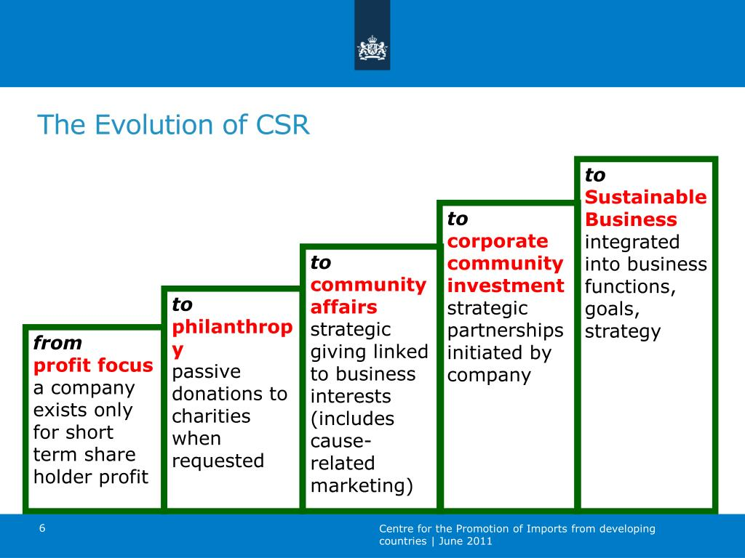

Slide 47
CSR In India
https://www.ijrte.org/wp-content/uploads/papers/v7i6s5/F10650476S519.pdf Case study
https://www.abacademies.org/articles/evolution-of-csr-with-special-emphasis-on-india-10171.html

Slide 48
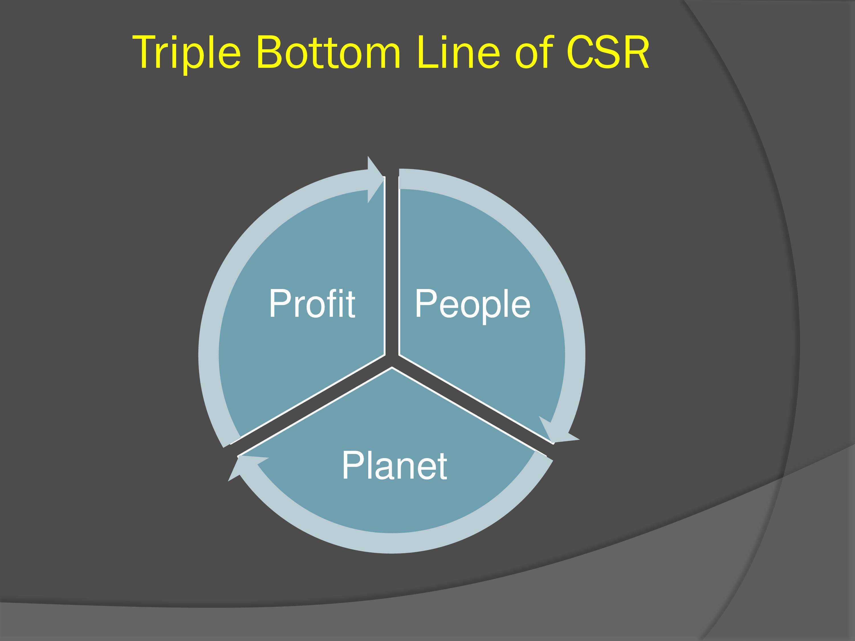

Slide 49
